Slide 1

Research Project Text-mining-based machine learning model for financial statement audit.
Proposed by: Liang Ou

Slide 2
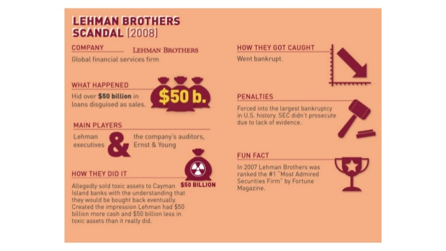

Slide 3
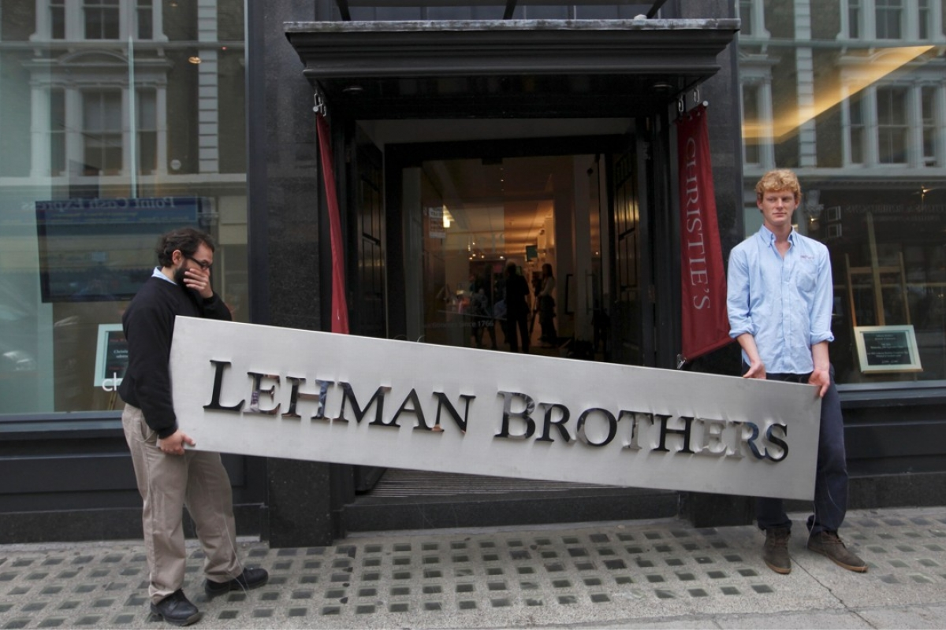
Causes Unemployment for Hundreds of People

Slide 4


Slide 5
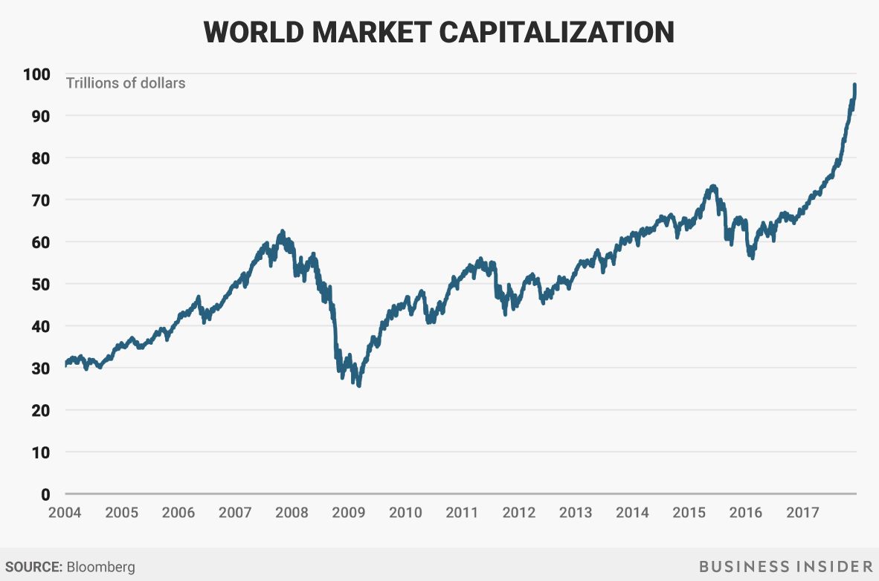
$10 trillion wiped out in 2008

Slide 6

Fail of Financial Statement Audit
Trust?
Corruption?

Slide 7

Fraud Detection by Machine Learning Model

Slide 8


Slide 9
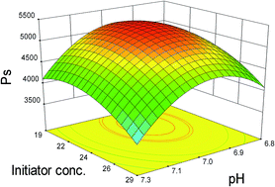
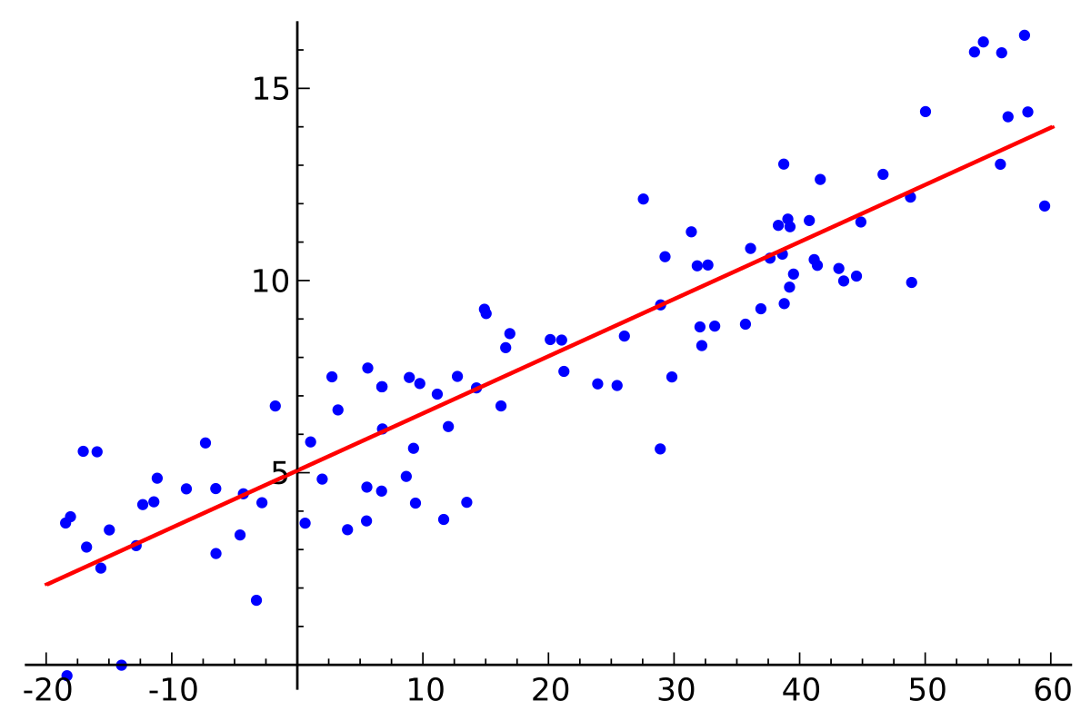
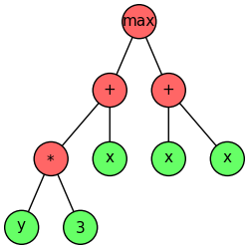
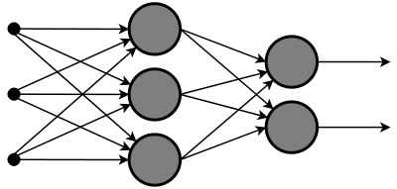
ML classifiers that have been explored

Slide 10



Not control by company under audit
Final Model

Slide 11

Project Team
Project Manager
Text-Mining Experts
Prediction Model Experts
Domain Experts

Slide 12


Project Expected Result

Slide 13

Thank You

